Slide 1

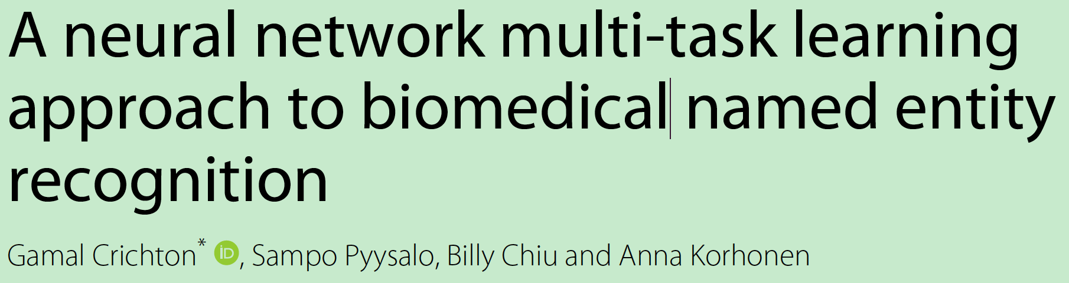

Slide 2
摘要
we develop supervised, multi-task, convolutional neural network models and apply them to a large number of varied existing biomedical named entity datasets.

Slide 3
介绍
Because
datasets are limited in size
and not available for many sub-domains of biomedicine [5, 6].
As a consequence, many NER systems suffer from poor performance [7, 8].

Slide 4
介绍
Multi-task Learning (MTL)
One potentially promising solution is to use multiple annotated datasets together to train a model for improved performance on a single dataset.
发现不同预料数据之间的联系

Slide 5
介绍
这篇论文想要做什么？
In this work, we investigate whether a MTL modeling framework implemented with CNNs can be applied to biomedical NER to benefit this key task.
we treat each dataset as a separate task

Slide 6
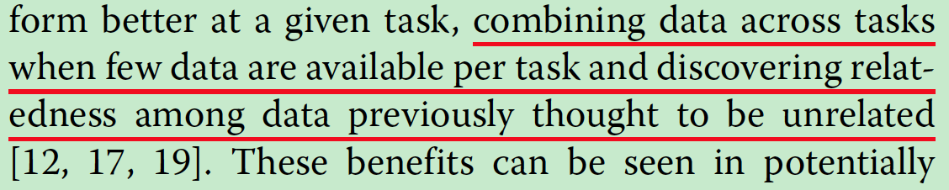
Motivation

Slide 7
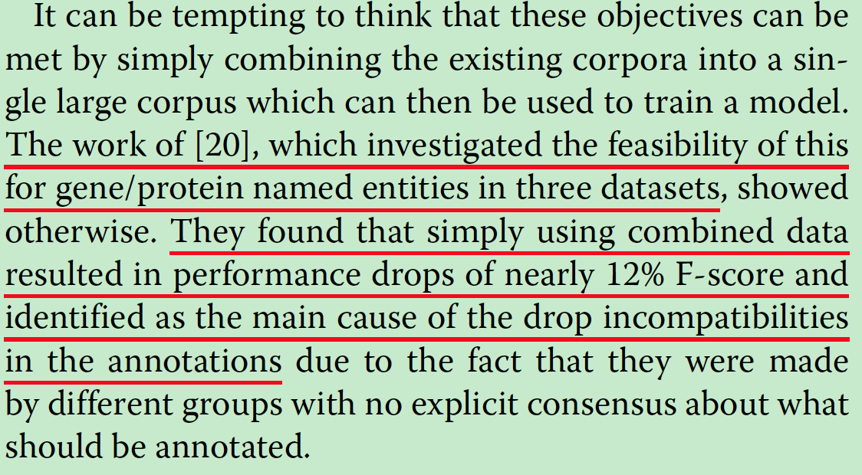
问题

Slide 8
方法
Pre-trained biomedical word embeddings
Chiu B, Crichton G, Korhonen A, Pyysalo S. How to train good word embeddings for biomedical NLP. In: Proceedings of BioNLP 2016. Berlin: ACL 2016; 2016. p. 166.

Slide 9
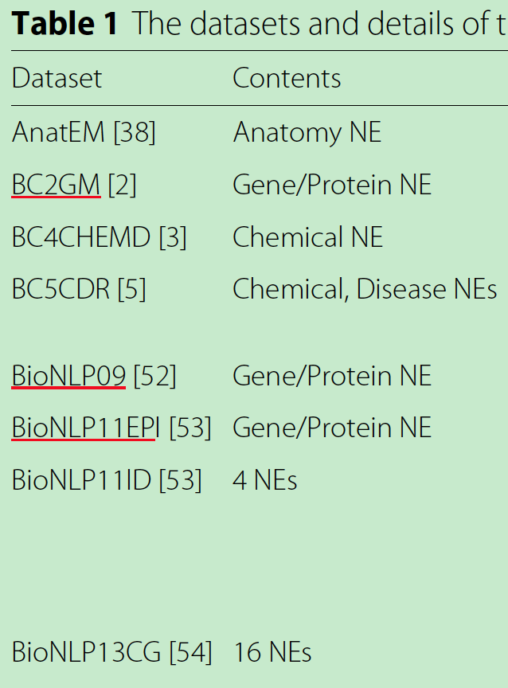
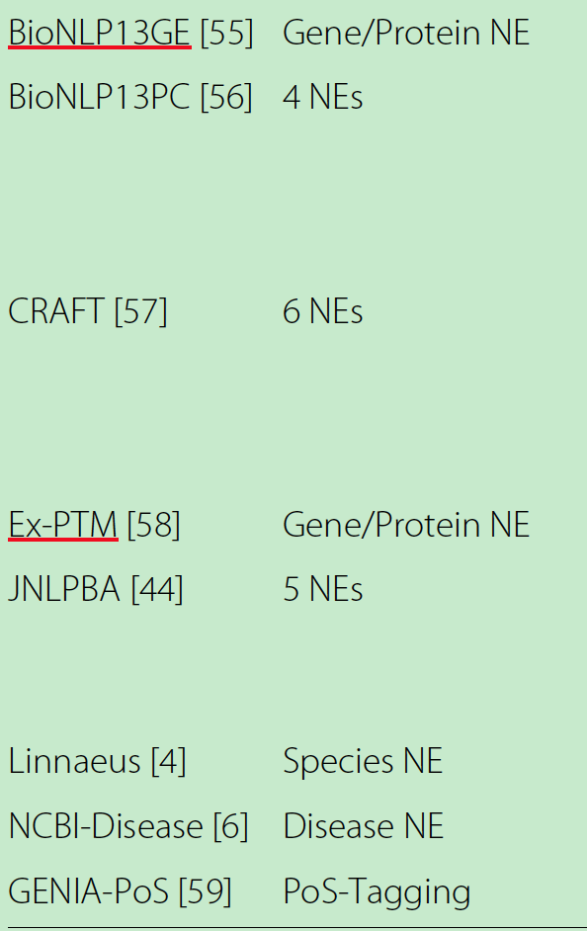
方法
Datasets（16个）
15 focused on biomedical NER
and one on biomedical POS tagging.

Slide 10
方法
sequential tagging task
Models were trained on the train section, their hyperparameters were tuned on the development section and the final evaluations were done on the test section.
Input: 词窗口上下文(N=3)
Output: Viterbi algorithm

Slide 11
方法
Baseline model
a feed-forward neural network
Single task model
no max-pooling after the convolution layer
Multi-output multi-task model
Dependentmulti-taskmodel

Slide 12
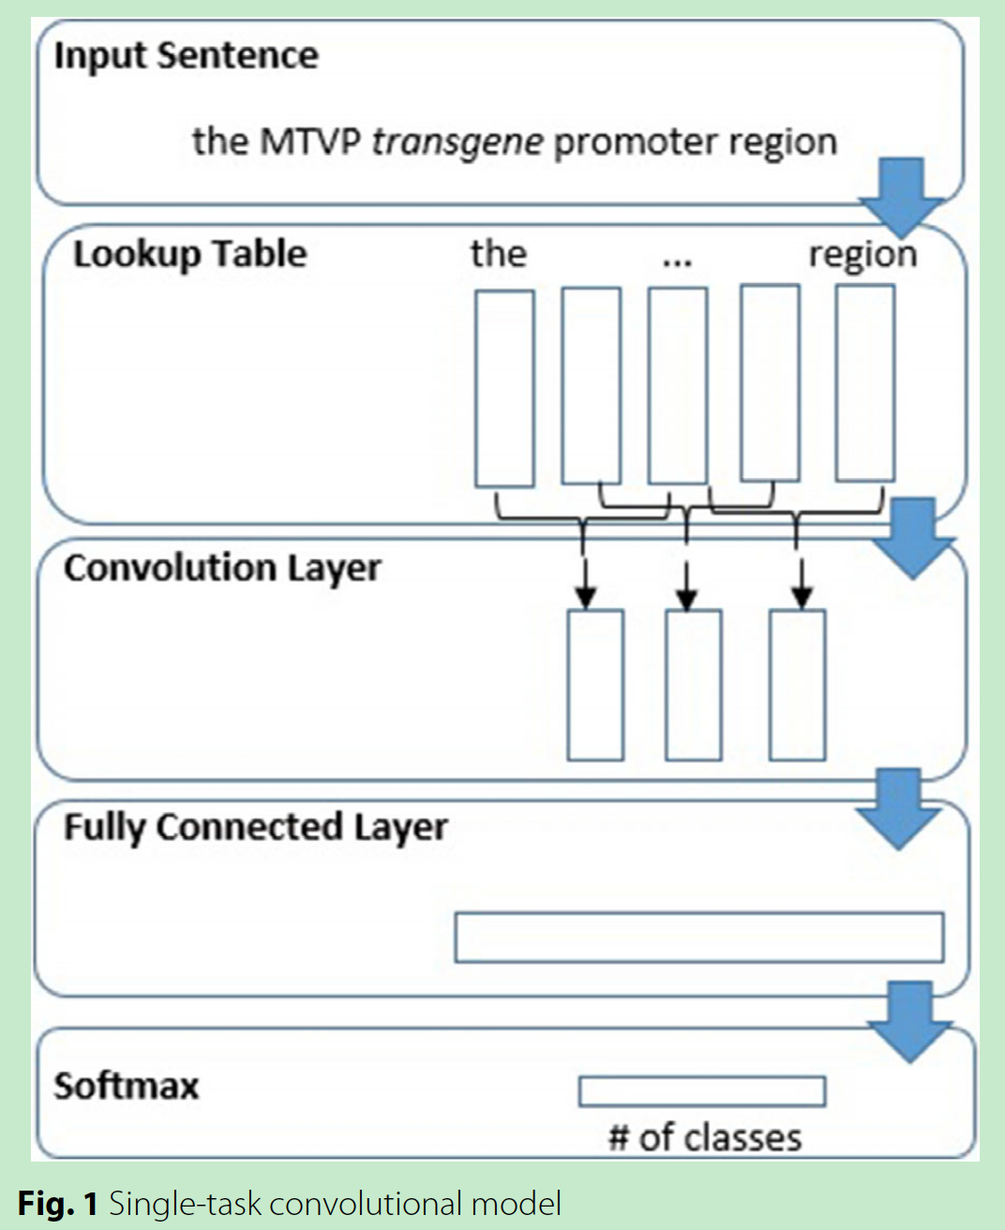
方法
Single task model

Slide 13
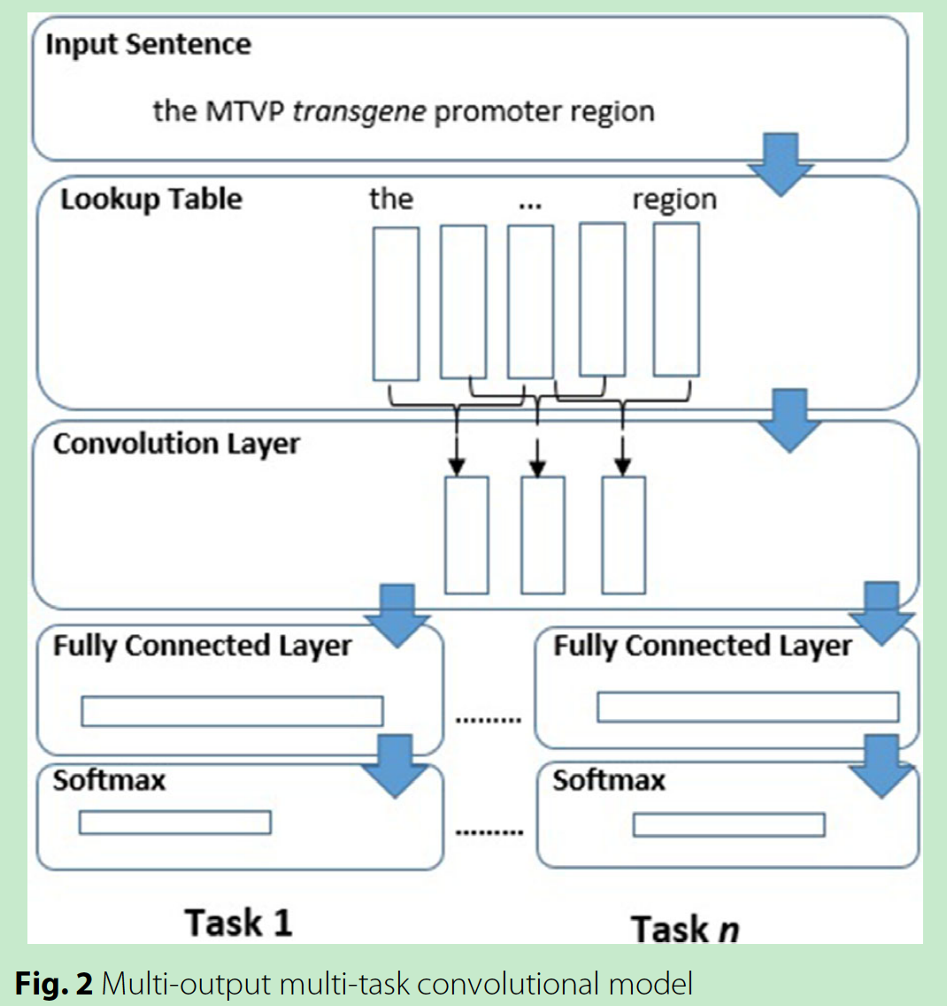
方法
Multi-output multi-task model

Slide 14
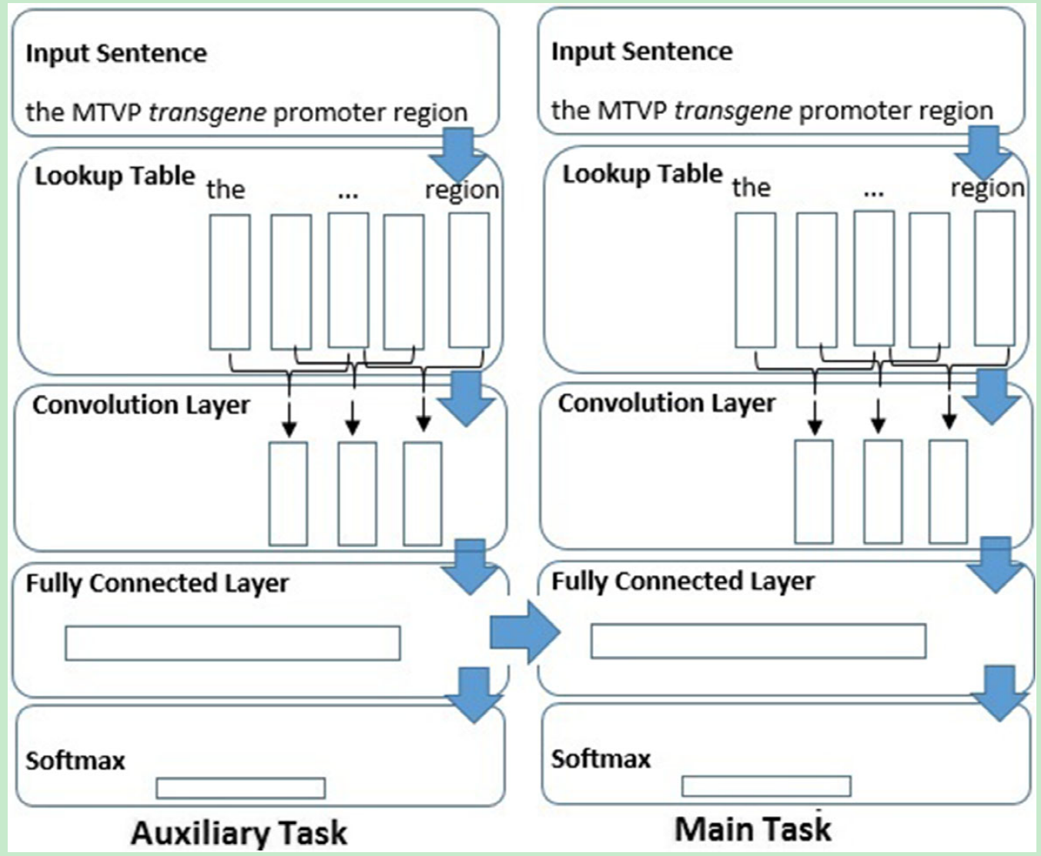
方法
Dependentmulti-taskmodel

Slide 15
实验
词的上下文窗口大小N=7
Mini-batch=50
Dropout=0.75
CNN filter大小={3，4，5}，各100个
学习率：0.0001
优化器：Adam

Slide 16
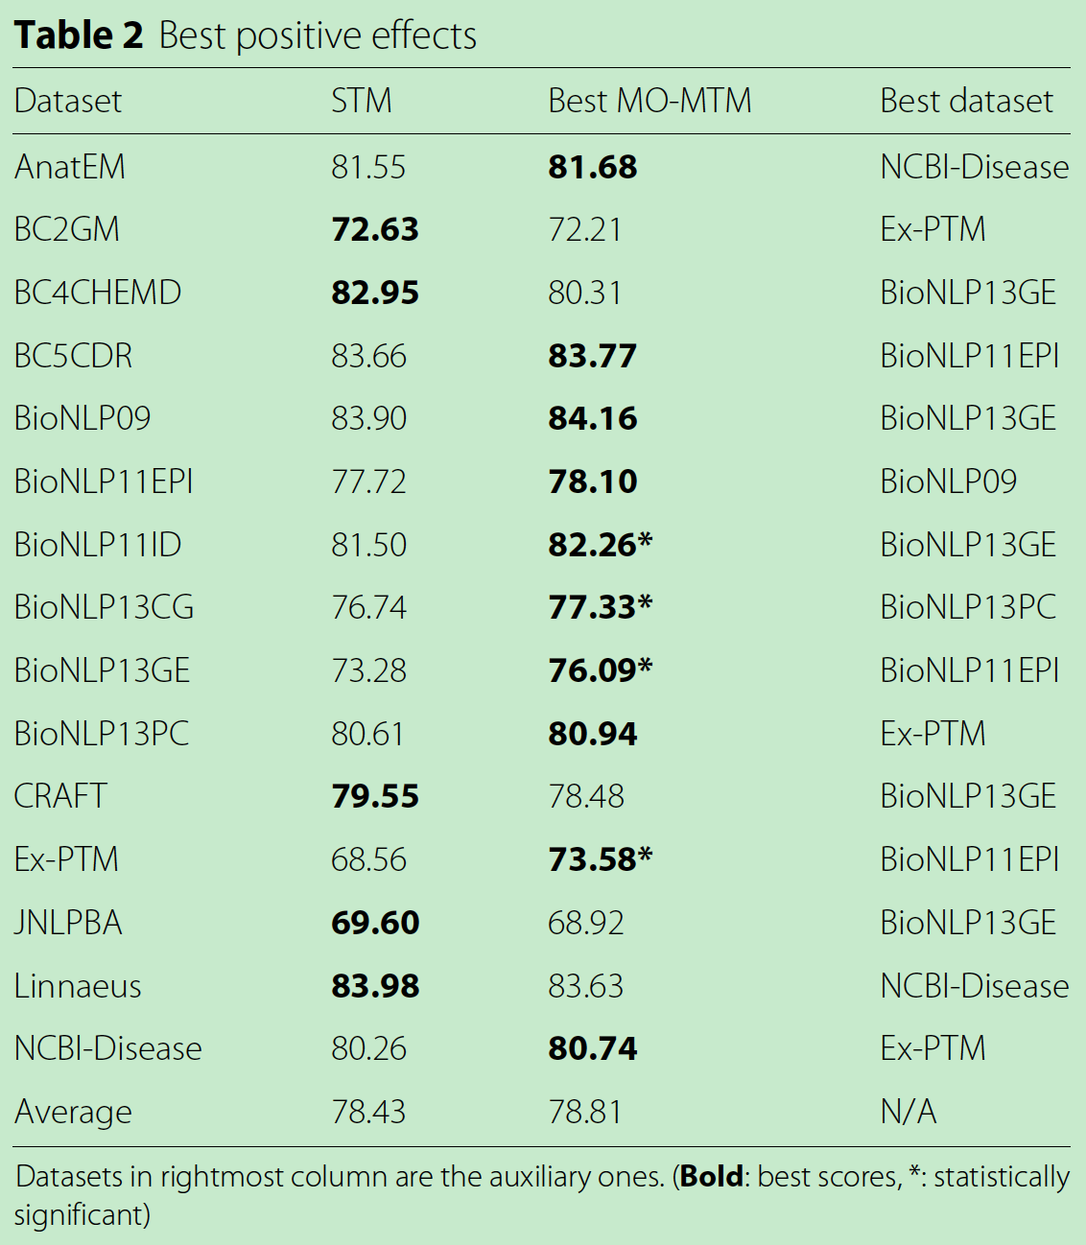
实验
STM
Single task model
MO-MTM
Multi-output multi-task model
D-MTM
Dependent multi-task model
The scores reported are macro F1-Scores

Slide 17
实验
An aim of this experiment was to determine which dataset had the most positive interaction with a particular dataset.
successful combinations were less predictable

Slide 18
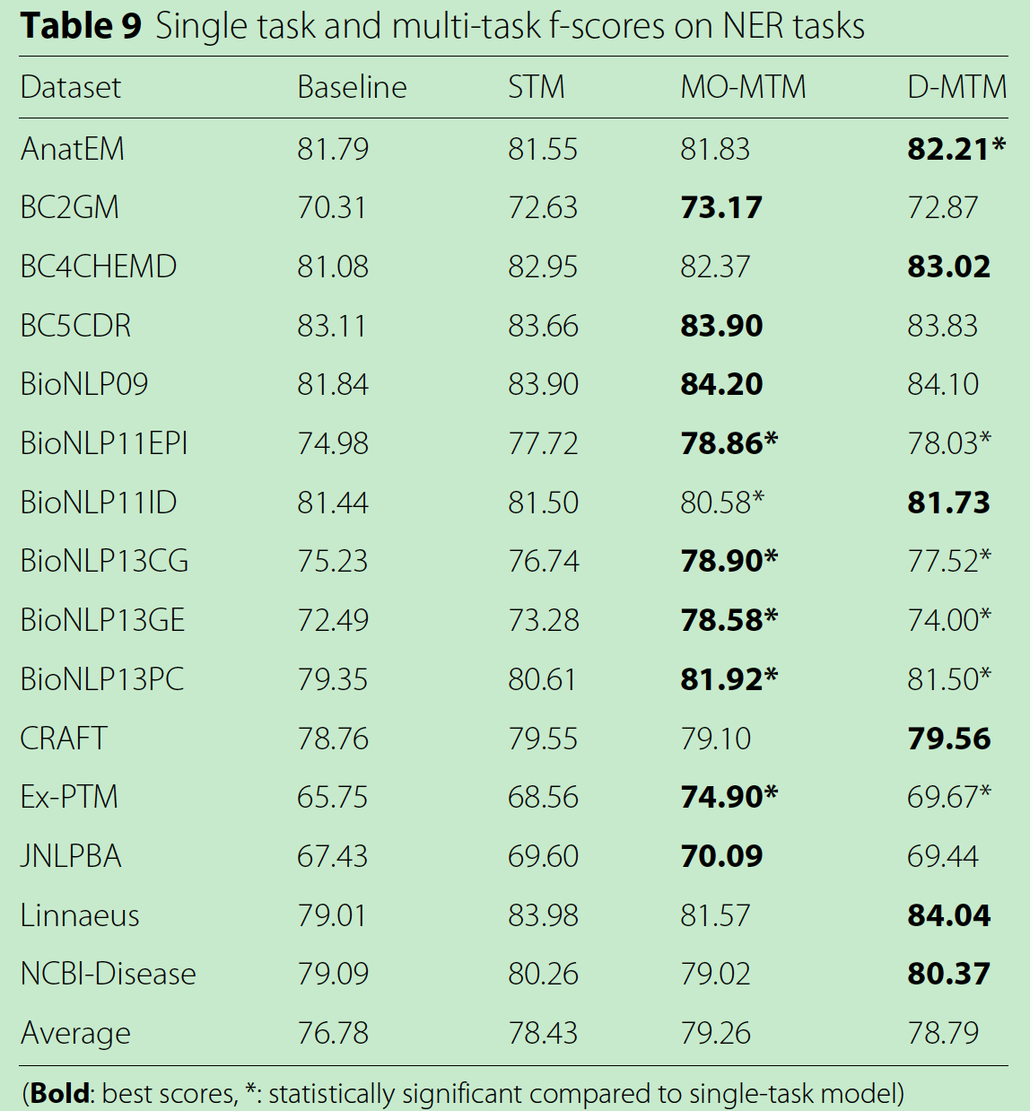
Multi-task learning on all datasets
This also provides evidence of MTL having a positive effect on the NER task
Dependent model was higher than that of the 15 separately trained models.

Slide 19
Dataset size and multi-task learning
Multi-task Learning to improve performance on small datasets.

Slide 20
Comparison with benchmark results
The BioNLP corpora
(BioNLP09, BioNLP11EPI, BioNLP11ID, BioNLP13CG, BioNLP13GE and BioNLP13PC) and the Ex-PTM corpus were introduced for event extraction tasks
the CRAFT corpus
was not primarily designed for NER
we focus on the remaining corpora:
AnatEM, BC2GM, BC4CHEMD, BC5CDR,
JNLPBA, Linnaeus, and NCBI-Disease.

Slide 21
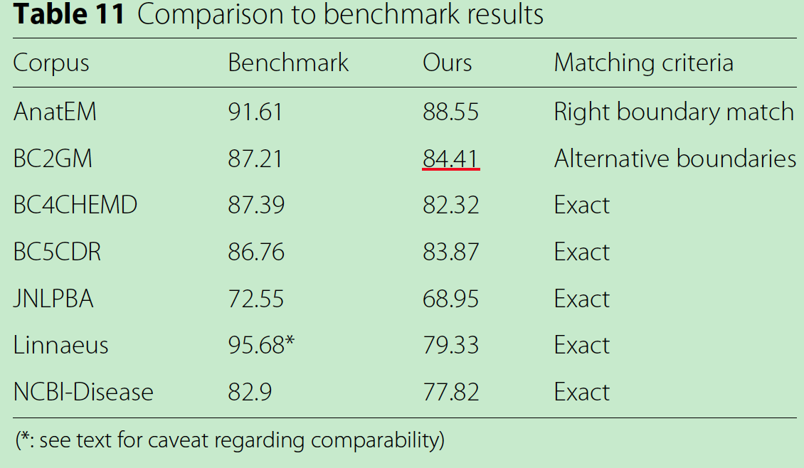
Comparison with benchmark results
AnatEM | 91.61% F-score for right boundary match
BC2GM | F-score of 87.21%
BC4CHEMD | 87.39% F-score
BC5CDR | achieved an F-score of 86.76%
JNLPBA | scored 72.55% F-score
Linnaeus | 94.3% recall and 97.1% precision (95.68% F-score)
NCBI-Disease | F-score of 82.9%

Slide 22
conclusion
We investigated whether Multi-task Learning could benefit the key text mining task of biomedical NER across various NER datasets.
We observed an average improvement on Multi-task Learning in comparison with single task learning.

Slide 23
生物信息学数据库
数据库是生物信息学的主要内容,各种数据库几乎覆盖了生命科学的各个领域。常用的有:
核酸和蛋白质数据库，如NCBI的核酸序列数据库、蛋白质数据库(UniProt)
基因芯片数据库，如高通量基因表达数据库(GEO)；
疾病相关数据库，如GeneCardsi(基因卡片)；
药物和疾病数据库(DrugBank)等。

Slide 24
生物信息学数据库
NCBI
GEO https://www.ncbi.nlm.nih.gov/geo/
SRA https://www.ncbi.nlm.nih.gov/sra
其他
ENSEMBL
在线学习 https://www.ebi.ac.uk/training/online/
EnsemblPlants http://plants.ensembl.org/index.htmls
蛋白质
EBI http://www.ebi.ac.uk/services/proteins
pfam http://pfam.xfam.org/
uniprot http://www.uniprot.org/
GPOFILER http://biit.cs.ut.ee/gprofiler/index.cgi
GO http://www.geneontology.org/
生物信息工具查询网站
https://bioinformatics.ca/links_directory/](https://bioinformatics.ca/links_directory/)
https://omictools.com/
https://www.atum.bio/resources/bioinformatics-tools
https://wiki2.org/en/List_of_RNA-Seq_bioinformatics_tools

Slide 25
生物信息学数据库
GenBank
美国国家生物技术信息中心 （NCBI）所维护的供公众自由读取的、带注释的DNA序列的总数据库
https://www.ncbi.nlm.nih.gov/genbank/
蛋白质序列数据库 SWISS-PROT
http://www.expasy.ch/sprot/
蛋白质分类数据库 ProtoMap
http://www.protomap.cs.huji.ac.il/
蛋白质结构数据库 PDB
http://www.rcsb.org/pdb/
UMLS
本体定义了135种语义类型
每个MeSH词都有固定的语义类型
大部分系统是研究CDR或蛋白质的相互作用，而涉及到基因的研究的语料都是从MEDLINE或UMLS数据库中利用SemRep工具处理得到相关疾病、基因和药物三者关联的语料集输出。

